Slide 1
Flight Delay Predictor
Team Pandas: Jason Bursey, Alyssa Gomes, Ruchan Harash, Diana Popa
USCS Data Analytics Boot Camp
September 2020

Slide 2
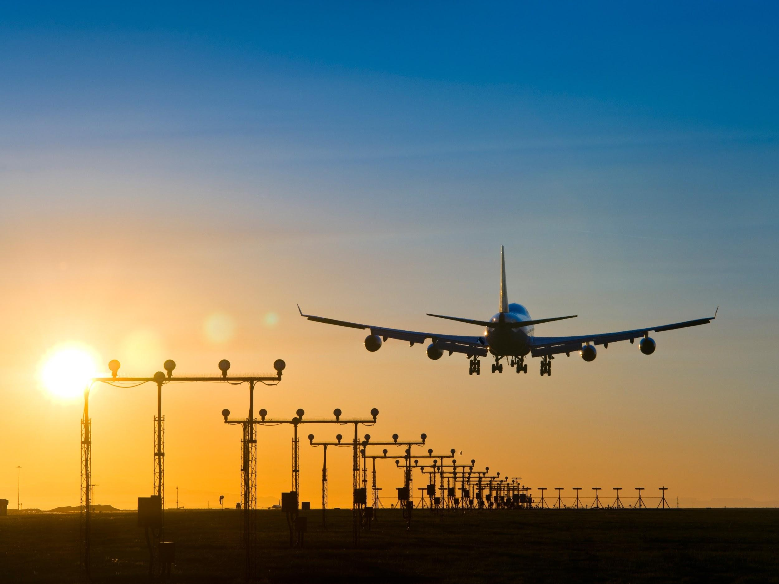
Notes:
Topic - Flight delays

Slide 3
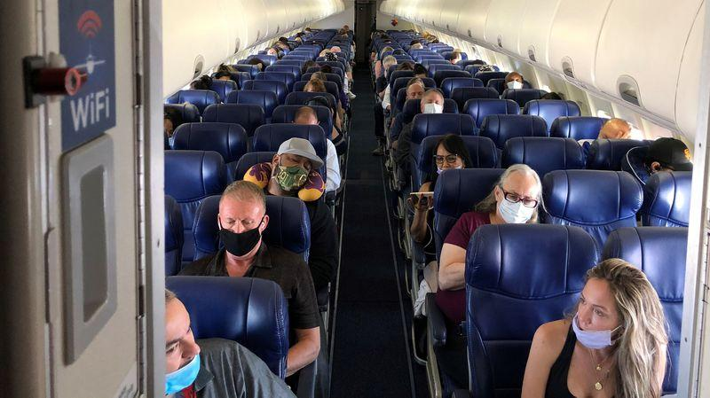
Notes:
Reasons we selected the topic
Air travel as we used to know it has been turned on its head because of the COVID-19 Pandemic. We are looking at flight delay data from 2015 to see which factors impact how many minutes a flight is delayed by. The airline industry is close to $900 billion in size worldwide as of 2019, with flight delays costing the industry $8 billion annually. Being able to predict which factors influence delays and by how many minutes, is the question airlines have been struggling to answer since their inception.

Slide 4
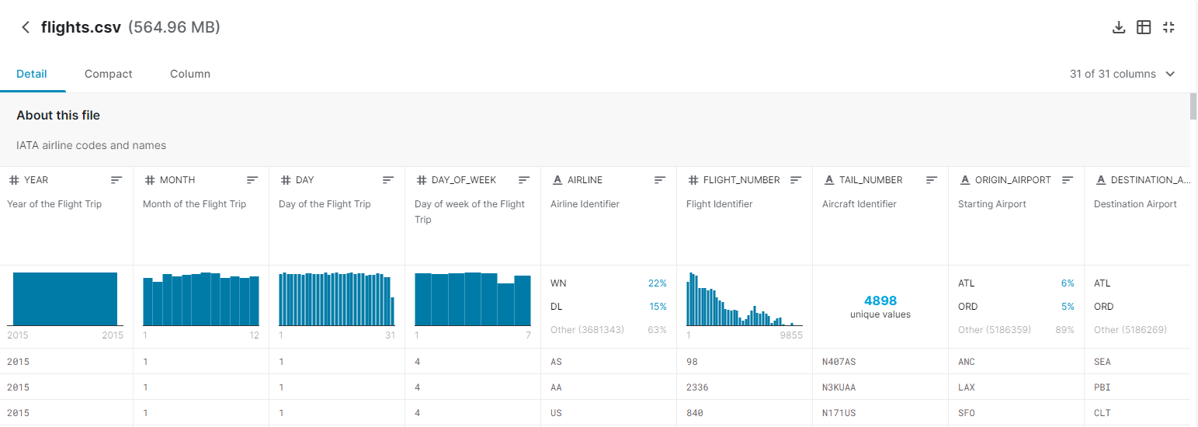
Source of Data
Notes:
This dataset provides information on the flights in 2015. Data includes the date of the flight, the airline, flight and tail number, the origin and destination airport, the times and distance associated with the flights as well as the reason for delay and if the flight was cancelled or diverted. With 31 columns and so much data, we will remove certain columns to clean the dataset. Those columns include the year because all this data is only for 2015. We will also remove the cancellation reason column because 98% of the values are null. As well, we will remove all the flights that were cancelled as it does not provide us with any data on factors that could’ve influence delay and we will remove the whole cancelled column as well.

Slide 5
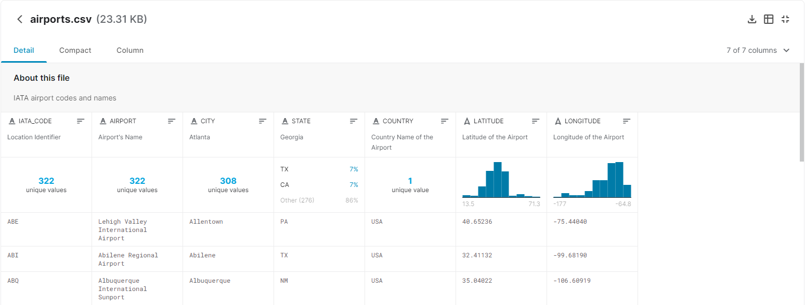
Source of Data
Notes:
This dataset includes information on the airports according to the IATA_CODE. Information includes the airport name, the city, state, and country the airport resides in, and the latitude and the longitude of the airport.

Slide 6
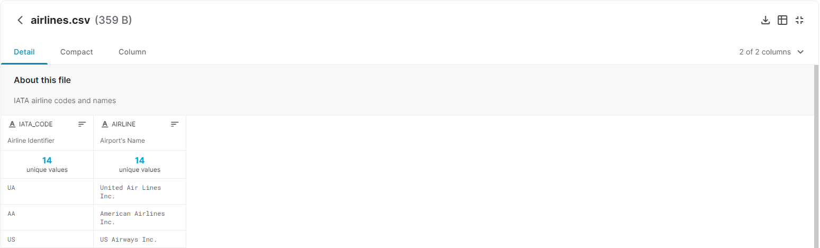
Source of Data
Notes:
This dataset provides information on the airlines including the code and airline name.

Slide 7
THANKS!
ANY QUESTIONS?

